Slide 1
Why Should We Care About Child Labor?
The Education, Labor Market, and Health Consequences of Child Labor
Kathleen Beegle
Rajeev Deheja
Roberta Gatti

Slide 2
Introduction
Extensive literature on the determinants of child labor but little evidence on the consequences of child labor
In theoretical literature, it is assumed that child labor has negative consequence but evidence that rigorously quantifies it is limited
So in this paper, the authors examine the impact of child labor on education, labor market and health among children attending school
They use data from rural households’ children attending school and instrument for participation in child labor with rice prices, a variable that influences child labor.
Results show that child labor has significant negative impact on education, a higher probability of wage work (the probability that those children will continue to work ) and mixed effects on health.
Notes:
there has been extensive literature on the determinants of child labor as we saw in our previous paper . but very little evidence on the consequences of child labor. In theoritcal literature , it is assumed that chiild labor has negative consequences but there is limited evidence. SO in this paper, the authors examine the impact of child labor on education,labor market and health among children attending They use data from rural households’ children attending school and instrument for participation in child labor with rice prices, a variable that influences child labor .We will find that five years subsequent to the child labor experience, there is significant negative impact no education, a higher prob of wage work , i.e the prob that those children will continue to work and mixed effects on health

Slide 3
Outline of this paper
Empirical Framework
Literature Review
Data
Consequences of Child labor
Conclusion

Slide 4

Empirical Framework
A. Base Specification and Sample Restrictions
2 rounds: Round 1(92-93) and Round 2(97-98)
T is participation of child labor in Round 1
Y is the outcome of interest(Grade completed,School enrollment etc) measured 5years later
X is household and community level controls
We identify the effect of child labor among those children who were in school in Round 1
However there are 2 potential sources of selection bias if we use OLS to estimate the eq within households and between households. To address these biases, we control for a range of HH characteristics such as parental education and HH expenditure in Round 1 and to control for within HH selection we use IV strategy
Notes:
In this section we outline the framwork we use to identify the effect of child labor on outcomes Our data has 2 rounds with round 1 bet 1992-93 and Round 2 bet 1997-98. and this is our base specification.The treatment T is defined as having participated as child labor in the 1st round of survey . Y is the outcome of interest(such as School enrollment,highest grade,health,etc) measured five years later and X is household and community level controls for child labor .We identify the effect of child labor among those children who were in school in round 1 because we believe that it provides a cleaner estimate the actual effect of child labor.
Now if we estimate the above eq using OLS, then Two potential sources of selection will occurr.between-household selection (that is, which types of households opt into child labor) and within-household selection (that is, which of their children parents select to work more or less).2 To address the first, we control for a range of household characteristics, including parental education and household expenditure in Round 1. Since within HH characteristics such as child abilities are diificult to measure,we address both sources of bias by using the instrumental variables strategy which we will see in the next slide.
Next we talk abt Instrumental variable specification but before that a quick reminder of what is

Slide 5
Instrumental Variable
Instrumental Variables (IV) is a method of estimation that is widely used. in many economic applications when correlation between the explanatory. variables and the error term is suspected. - for example, due to omitted variables, measurement error, or other sources.
2 conditions for instrument variable are:
It should be correlated with the explanatory variable, in our case, child labor.
It should not be correlated with the error term, unobserved characteristics

Slide 6

B. Instrumental Variables Specification
In Eq 1 , Z is the instrument and in eq 3, two stage least squares adjustment is made
Why is rice price the instrument?
Timing of the 2 rounds provides us a source of variation in child labor unique to Vietnam, which is rice prices
1992-1993 –high regulation in rice trade , 1997-98-trade liberalization. So there was substantial variation in prices which we argue is relevant to child labor.
Relevant because rice prices affect both demand and supply of child labor. (higher price will encourage more rice production and hence greater demand for child labor. Higher prices would also have an income effect on rice producing HH leading HH to reduce the supply of child labor)
Notes:
This is our instrument variable specification. In eq 2 , Z is the instrument and in eq 3 we make necessary 2stage least square adjustments. Now you may want to know that why rice price is the instrument for child labor participation T. Remember that we use IV when we suspect correlation between the explanator var and the error term and an ideal instrument wud be one that wil cause variation in child labor that is exogenous and that affects the outcome Y solely thru the child labor . And the timing of the 2 rounds provides us with a source of variation that is unique to vietnam, which is rice prices. Prior to 1970 Vietnam market was heavily regulated which is why there were substantial variation in prices which we argue is relevant to child labor and exogenous.
After 1997 trade in rice was liberalized and so rice price in R1 is not corelated with rice price in R2. Thus we use the price of rice in R1 as our instrument Now how is it relavant? Well rice prices affect both the demand and supply of child labor. Higher rice prices could lead to the decision to cultivate more rice, and hence increase the demand for child labor. Higher rice prices also would have an income effect on rice-producing households, leading households to reduce the supply of child labor . Hence rice prices are relevant in determining child labor decisions.
Instrumental V is a method of estimation when we suspect corr bet error and exp var(T). 2SLS is :1.we use instrument Z as exp var to predict T. Then we use the pred T to find Y.

Slide 7
Literature Review
A. The child labor-Schooling Tradeoff
Patrinos and Psacharopoulos (1995) show that factors predicting an increase in child labor also predict reduced school attendance and an increased chance of grade repetition.
Akabayashi and Psacharopoulos (1999) show that, in addition to school attainment, children’s reading competence (as assessed by parents) decreases with child labor hours.
Cavalieri (2002) uses propensity score matching and finds a significant, negative effect of child labor on educational performance.
Ravallion and Wodon (2000) indirectly assess this relationship in their study of a food-for-school program in Bangladesh that exploits between-village variation in program participation. They find that the program led to a significant increase in schooling, but only one-eighth to one- quarter of the increased hours of schooling were attributable to decreased child labor. This suggests that child labor does not lead to a one-for-one reduction in schooling.
Notes:
Here the authors reviewed some exisiting literature regarding the tradeoff between child labor and schooling.

Slide 8
Hence, in this paper the author makes 3 contribution beyond these studies:
First, we use instrumental variables to try to address the selection biases that emerge in child labor studies.
Second, we examine education together with a labor market outcome (the probability of wage work) which allows us to take a first step in addressing the question of the net impact of child labor
Finally, we also consider the health consequences of child labor.

Slide 9
B. Previous research on Vietnam
Vietnam experienced rapid growth in the 1990s ,characterized by decline in child labor. Edmonds and Turk(2004) documents the sharp decline in child labor in the 1990s and Edmonds links this to improved living standards.
Edmonds and Pavcnik(2005) examined the effect that integration of Vietnam’s rice market had on child labor markets. Finds that increase in rice prices leads to reduced child labor. This results motivates the 1st stage of our 2SLS procedures.
O’Donnel,Rosati and Doorsaler(2005) investigates the impact of Vietnam child labor on health and using instrumental variables, find no impact on growth of the child but some evidence that work during childhood increases the likelihood of falling ill or injury.
Notes:
The authors also reviewed some literature relating to previous research on Vietnam .

Slide 10
Data Description
Data is taken from Vietnamese Standards survey, a survey conducted both in 1992-93 and again in 1997-98
Survey contains information on HH composition, time use for children, educational attainment and labor market activities of HH members
Community survey was also conducted to gather information such as presence of schools, roads, electricity , local rice prices and occurrence of disasters.
For this paper, we use info on the panel of rural HH with children between ages 8 and 13 of the 1992-93 survey

Slide 11
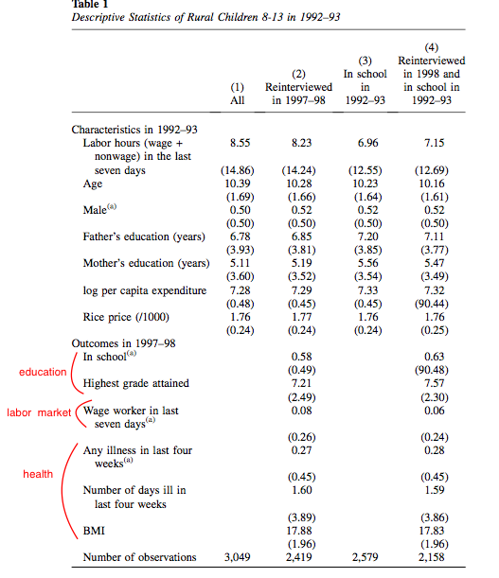
Notes:
This table provides an overview of our data. there are four samples: all children in 1993, the subset of these children reinterviewed in 1998, children in 1993 in school, and the subset of these children who were reinter- viewed. This last sample of 2,158 children is the group on which we will conduct our subsequent analyses .And then we measure child labor hours as the total hours the child was engaged in income-generating work, including work on the family business or farm. Mean Age is around 10 in all 4 samples and gender distribution is balanced. Other variables we took into account are parental education and per capita expenditure in log
The middle section summarizes our instrument variable-community level rice prices in 92-93 which we use to identify the decision to send a child to work
the next section summarizes the outcomes. In the second survey in column 4 , 64% of children are in school overall. We also see that highest grade attained is higher among working children than non working ones. Like its 7.21 and that’s 7.57
Finally we note that children who work in Round 1 do not appear to be more likely to be working for a wage by Round 2. It can be seen by the magnitude of the coeeficients of the variable wage worker in last 7 days.
And the health outcomes are not so high among the working children compared to non-working children. Such as 28% working children was ill in last 4 weeks while for non working it is 28%. SO there really isnt a sig difference between the two

Slide 12
Results
A. OLS
B. Instruments : Relevance and Exclusion
C. Main Results
D. Robustness of Results and Instrument
E. Health Effects
Notes:
The results are divided into 4 sections

Slide 13
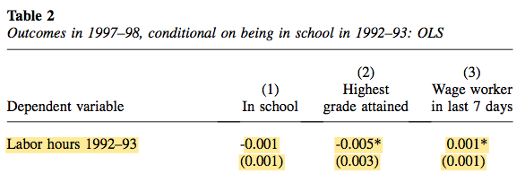
A. OLS
Notes:
We begin by discussing the OLS relationship between child labor and our outcomes. In looking at the first row of Table 2, we note that child labor in the first round is significantly associated with two outcomes: highest grade attained falls and the probability of wage work rises with more child labor . More child labor also causes lower attendance, although this effect is not statistically significant

Slide 14
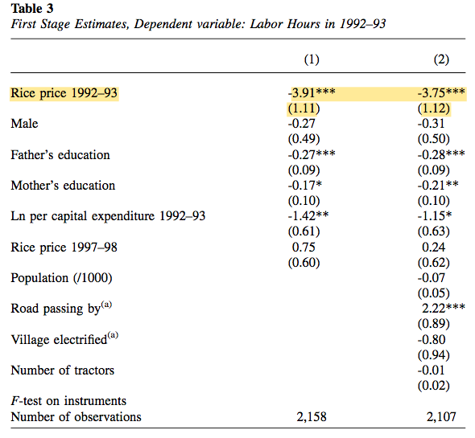
B. Instruments: Relevance and Exclusion
Notes:
In Table 3 we present the first stage of our instrumental variables regression. Column 1 reports our basic specification, with rice prices as our instrument. Rice prices are a highly significant predictor of child labor, with an F-statistic of 13.75. Higher rice prices are associated with reduced child labor, suggesting that the income effect dominates the labor demand effect .
In Column 2 we present an alternative specification where we include additional community controls such as population, distance to roads, electrification, and number of tractors because these are potentially relevant for selection into child labor at the community level and could affect the validity of the exclusion restriction. For example, rise in number of tractors could reduce demand for child labor. However, We find that the coef of rice prices is almost similar to column 1 and our instrument is significant at 1 percent

Slide 15
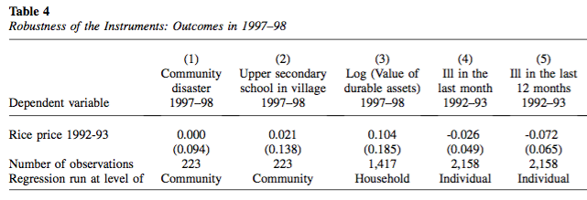
Notes:
Our concern is also that the instrument may be correlated with an omitted variable which could violate the instrument’s exclusion restriction. for example rice prices are related to agricultural production which could be correlated with community attitudes toward child labor, i.e more child labor would be demanded for more production to grasp greater revenues. Rice prices could also drive changes in household income.
So in order to test the validity of the instrument we examine their correlation with a range of relevant variables that are observed.. In table 4 we test the robustness of our instruments. Here we consider whether rice prices predict future occurrence of shocks and we see there is no significant relationship. . In colum 2 we check whther rice price is correlated with the presence of secondary schools(Presence of sec schools reflect a preference fr education ,hence less child labor ) and even here we find no sig effect Similarly, no significant effects for household wealth measured by the value of durable assets or on incidence of illness among children .Overall these results support our use of rice prices as a valid instrument for child labor.

Slide 16
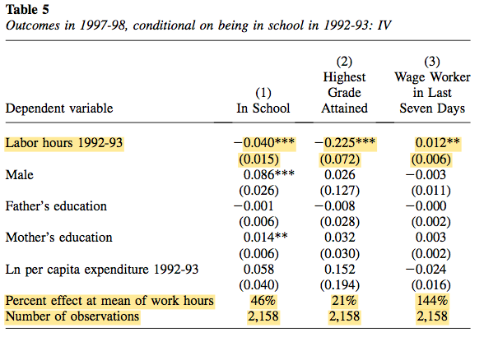
C. Main Results
Notes:
In Table 5, we present our benchmark results. In column 1 we see that Working as a child during the first survey round leads to a significantly lower level of school attendance five years later. The mean level of child labor leads to a 46 percent reduction in school attendance.
In Column 2 we show results for highest grade completed. We see that the effect is negative and significant at the 1 percent level; children who worked in the baseline survey have a significantly lower level of educational attainment. A mean level of child labor leads to a (21 percent) decrease in educational attainment.
Finally in Column 3 we see the impact on the likelihood of wage work after 5 years and it is positive and significant . Infact at the mean level of work, child labor more than doubles the likelihood of being a wage worker in the second round of our survey
An interesting thing to note here is that our IV estimates are larger than OLS estimates. Now generally, OLS should overestimate the impact of child labor on schooling to the extent that families send their less academically gifted children to work and child ability cannot be measured wheras IV estimates the causal effect. but our results instead support the view that families send their more academically gitfted children to work, possibly because they are also more productive and so IV estimates are larger than OLS.

Slide 17
D. Robustness of results and Instrument
we will try to rule tout 2 arguments against our instrument to prove robustness.
The first concern is that Southern Vietnam is a rice-growing region, whereas Northern Vietnam is a rice deficit region. In 1992–93, there were severe restrictions to trade across regions, which led to lower rice prices in the South than the North .If low rice price (high child labor) areas experienced relatively more rapid development of their labor markets, then this could explain the results for wage work increases among children working in the first survey round.
To test for this, we use our base specification to estimate the effect of adult work on adult earnings five years later. If the wage work result were simply due to a labor market effect, then we would expect to find a significant effect for adults
Second concern is that North and South could differ in their levels of attitudes toward, education and child labor. We test for this by restricting our sample to communities in the North.
Notes:
Here we will try to rule tout 2 arguments against our instrument to prove robustness.
The first concern is that Southern Vietnam is a rice-growing region, whereas Northern Vietnam is a rice deficit region. In 1992–93, there were severe restrictions to trade across regions, which led to lower rice prices in the South than the North .If low rice price (high child labor due to low income) areas experienced relatively more rapid development of their labor markets, then this could explain the results for wage work increases among children working in the first survey round. To test for this, we use our base specification to estimate the effect of adult work on adult earnings five years later. If the wage work result were simply due to a labor market effect, then we would expect to find a significant effect for adults. Go to table
Second concern is that North and South could differ in their levels of attitudes toward, education and child labor which could change our outcomes. So We test for this by restricting our sample to communities in the North.

Slide 18
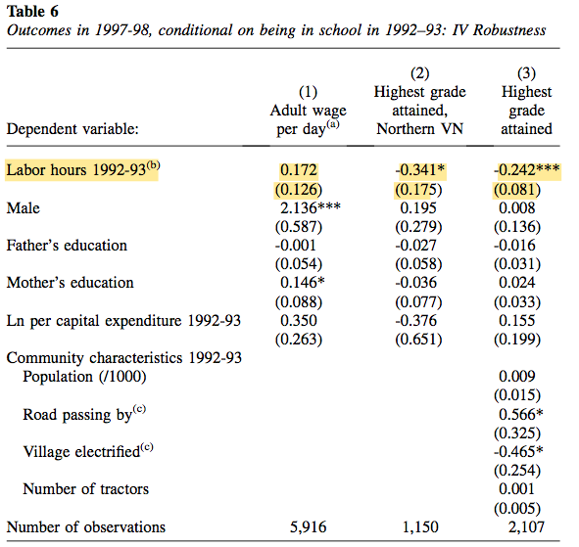
Notes:
However,in Table 6 we do not find any significant effect as shown under column 1.
And If we look at Table 6, This is presented in Column 2 for highest grade attained, and the child labor effect is similar in sign and significance to our base results previously shown in Table 5.
Next , we are more concerned that the instruments may not be excluded from the outcome equations. And we address this controlling for certain community variables that may drive the rice price differences . For instance population drives the demand for rice here and on the supply side of rice, we control for variables such as presence of roads, use of tractors,and technology such as village electrification.In Coumn 3 we see the results for highest grade obtained and this is also similar in sign and magnitude to Table 5

Slide 19
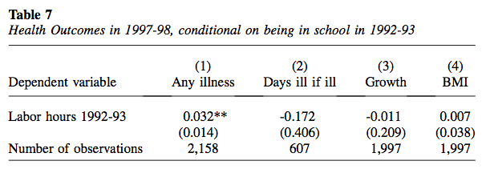
E. Health Effects
Notes:
Improved health status is widely recognised to lead to greater economic productivity and existence of significant health effect could either offset or reinforce a tradeoff between child labor and wellbeing. For instance, worse health could offset some of the potential gains from increased participation in wage work .
In this section we examine the effect of child labor on subsequent health outcomes.
First, we examine an indicator of whether the individual had any illness in the previous four weeks,. The second health measure is the number of days the individual suffered from any of these illnesses in the previous four weeks if sick . Third, we use body mass index (BMI), an indicator of current nutritional status associated with physical health and it is positively related to productivity and earnings.
Column 1 shows that child labor significantly increases the probability of illness. In Column 2 we see that the number of days ill among those who have been ill does not significantly increase with child labor . And We find no significant impact of child labor on growth or body mass index in clmn 3 and 4. Overall we can say that the results on health outcomes are mixed.

Slide 20
Conclusion
Moral distaste for some extreme types of child labor is beyond question
However, in developing countries most child labor is rural and a relatively low intensity activity
So it is important to determine empirically that to what extent child labor has harmful consequences for children in later life
And this paper is viewed as a step in this direction
We find that child labor significantly reduces school attainment
We also find that child labor is associated with an increased likelihood of wage work, which is linked to higher living standards. Increased participation in this activity implies the possibility that some of the negative effects of foregone schooling could be offset by the benefits of earlier work
Hence these results suggest that there could be some medium run economic benefits to child labor in addition to costs we have discussed

Slide 21
Critique
One limitation of the present analysis is that there was no data for wage rates such as individual earnings for work ,wage or self employment . That could have enabled us to quantify the impact of child labor on future earnings rather than just estimating a likelihood.
Also no data on labor productivity such as agricultural productivity. Availability of these data could have allowed us to compare the costs of child labor in terms of lower schooling with potential economic returns in terms of income.
Could have extended the time horizon of study. It would allow for a longer term analysis of the costs and returns to to work experience when young.

Slide 22
THANK YOU!

